Slide 1
Cyclist
Case Study
By: John Sheppard
Last Updated: July 1st, 2022

Slide 2
Table of Contents
Bike usage 04/2020-06/2021
Overall usage
Conclusion
Recommendations

Slide 3
Objective
How do annual members and casual riders use Cyclistic bikes differently?
How did members and casual riders use each bike
What percentage of rides where by members or casual riders

Slide 4
The usage of each bike type
Notes:
This is going to show us what bikes are being used and by whom. This will show us how much each type of bike is used. This will allow us to understand what types of bikes we need to get more of and or what parts are going to be needed.

Slide 5
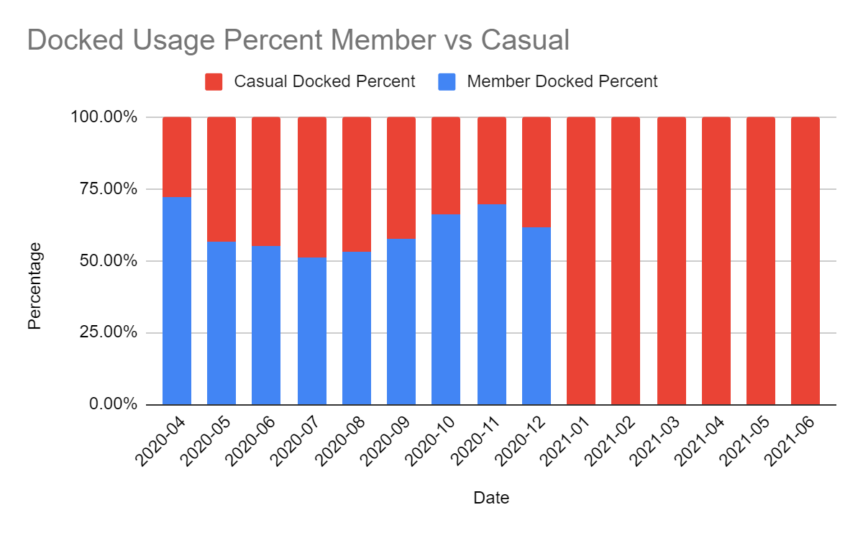
Docked Bike
Casual users got close to 50% in the summer months
Members consistently used over 50% until 2021 when they dropped to 0%
Notes:
What this is showing us is if there was 100 docked bikes what percentage of them would be used by members or casual riders. As we can see in 2021 only casual riders

Slide 6
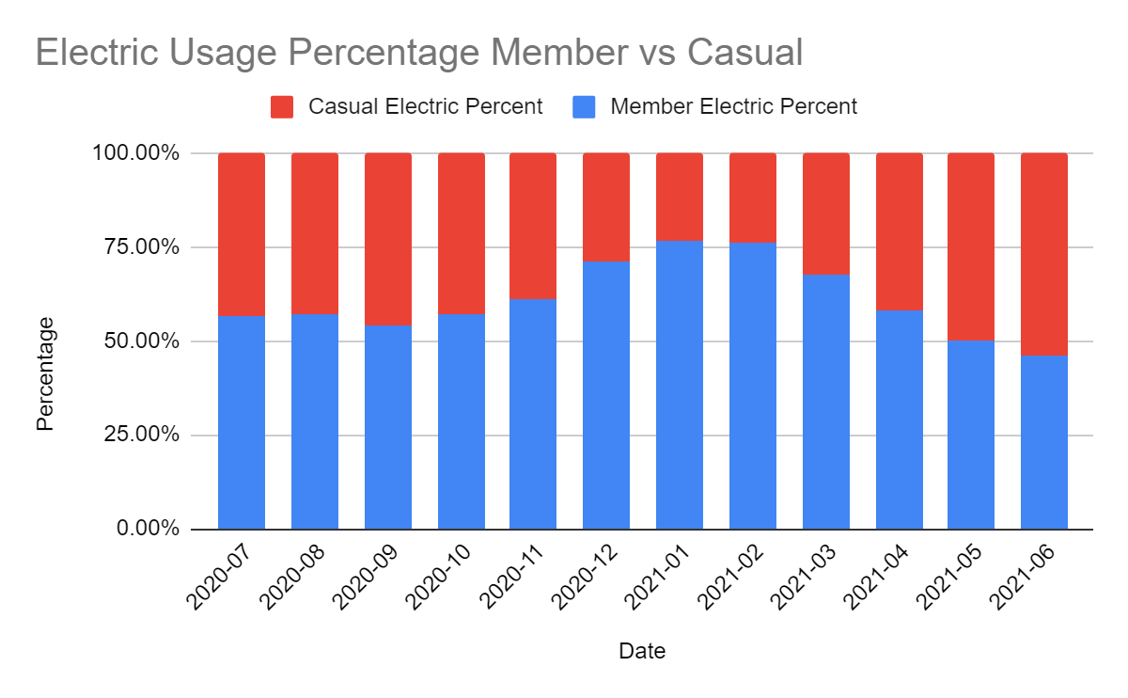
Electric Bike
The electric bike was introduced in July of 2020

Slide 7
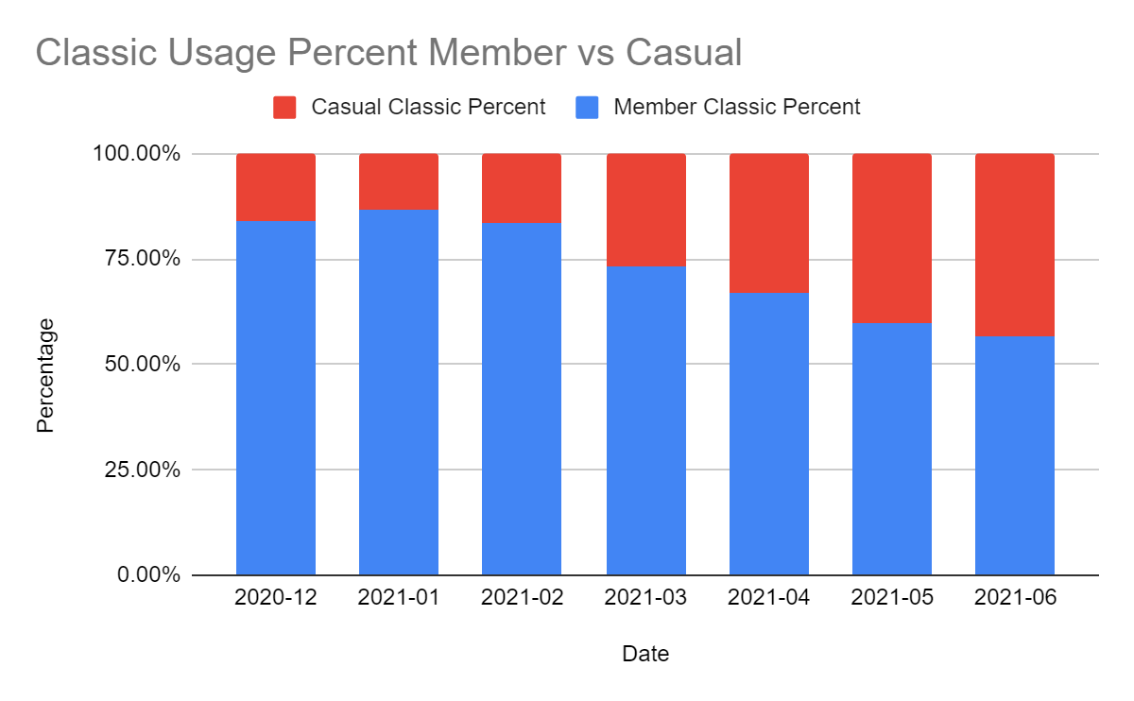
Classic Bike
The classic bike was introduced in December of 2020
Since the introduction this has been the preferred bike for members

Slide 8
Overall usage

Slide 9
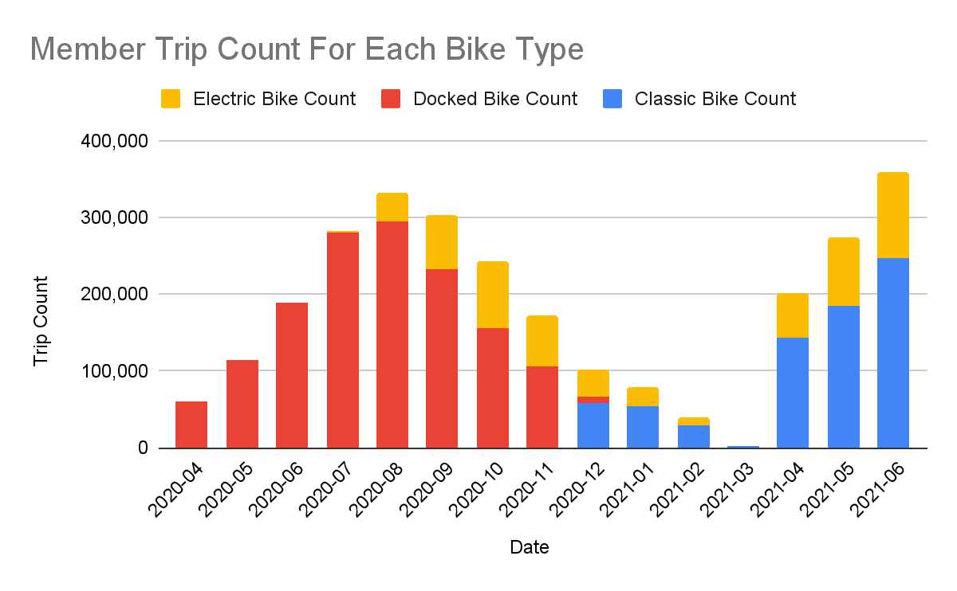
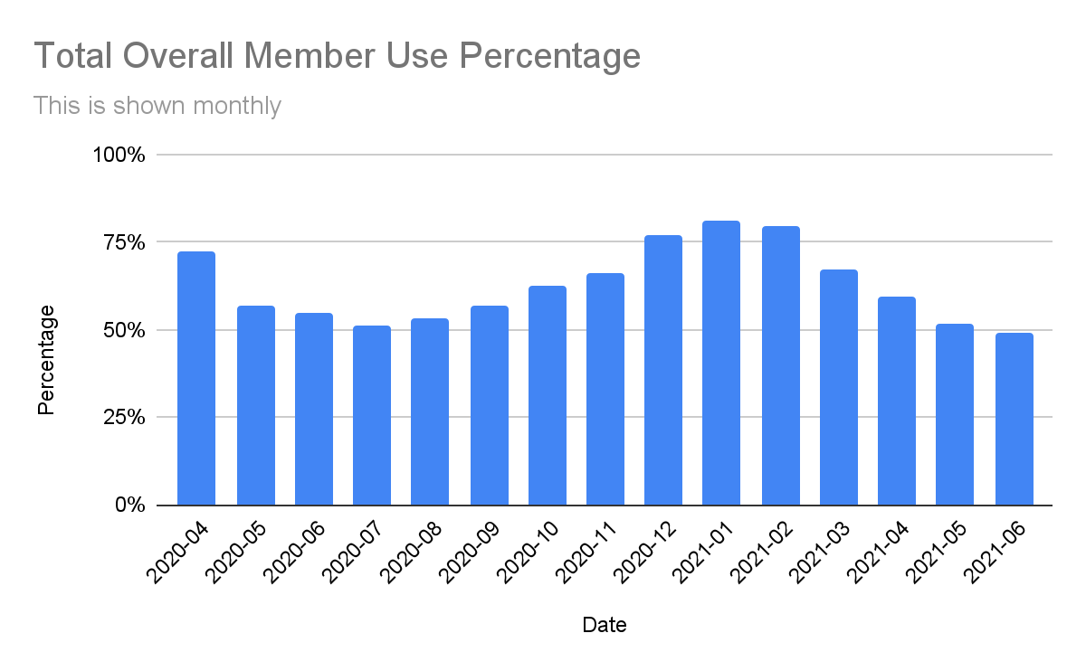
Members Usage
The classic bike is the preferred bike after its introduction
We can see how consistently members make up our percentage of trips
Notes:
This is showing the total number of rides for the members for each month for 14 months. This is also showing us what type of bike they are using.

Slide 10
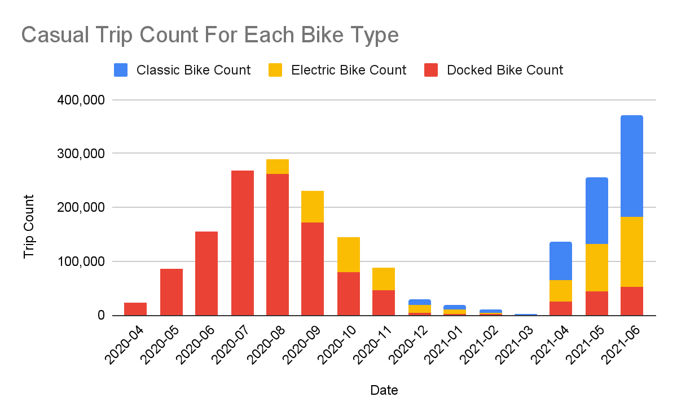
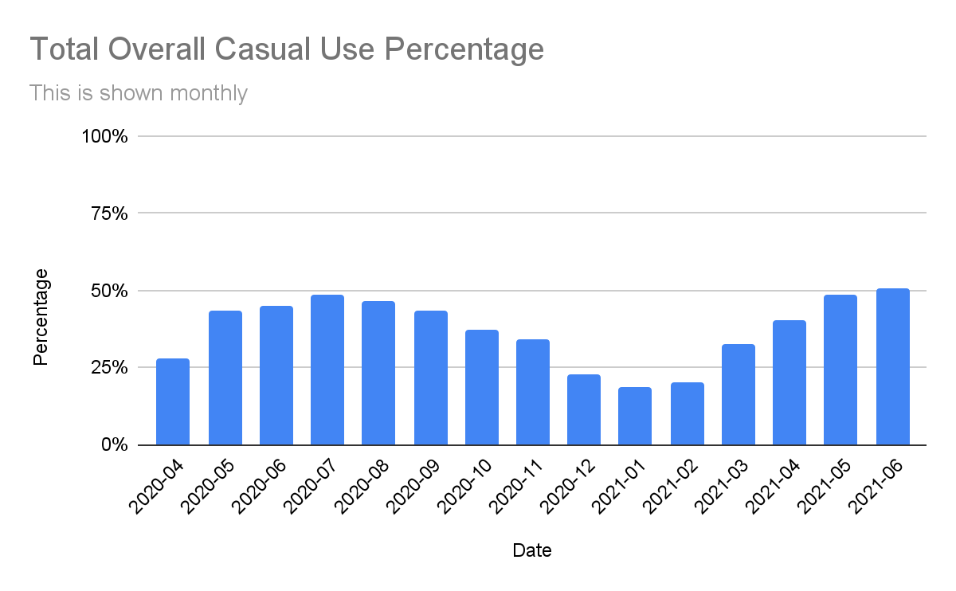
Casual Usage
We can see that Casual users will ride on anything but prefer the Classic bike
Casual users are very seasonal in their percentage of trips

Slide 11
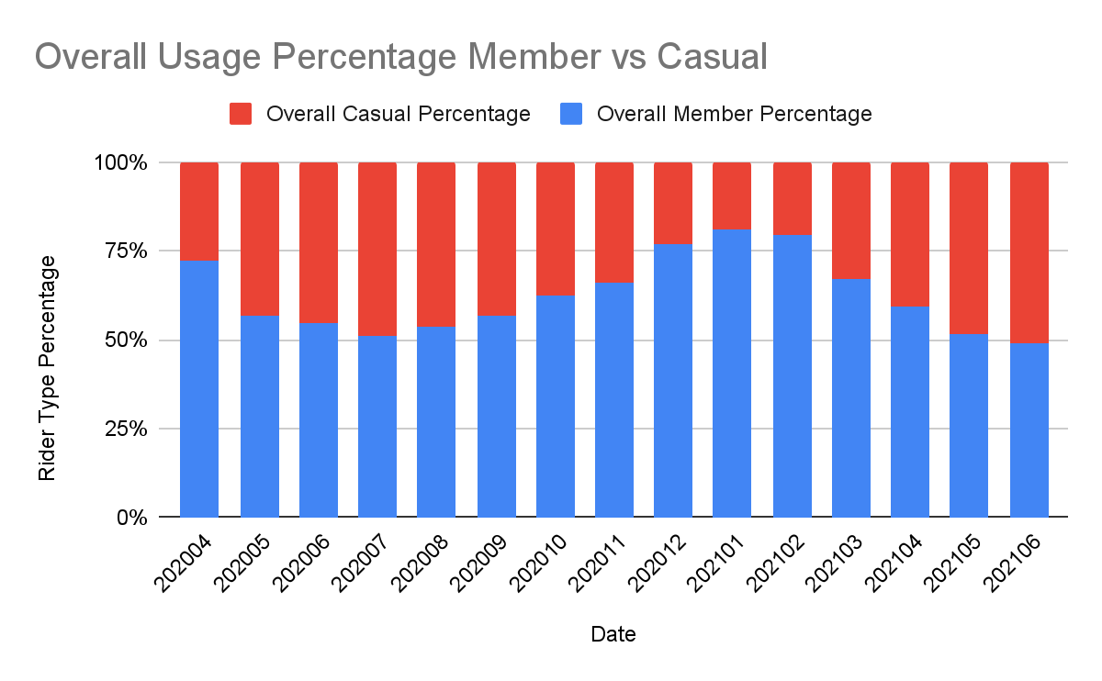
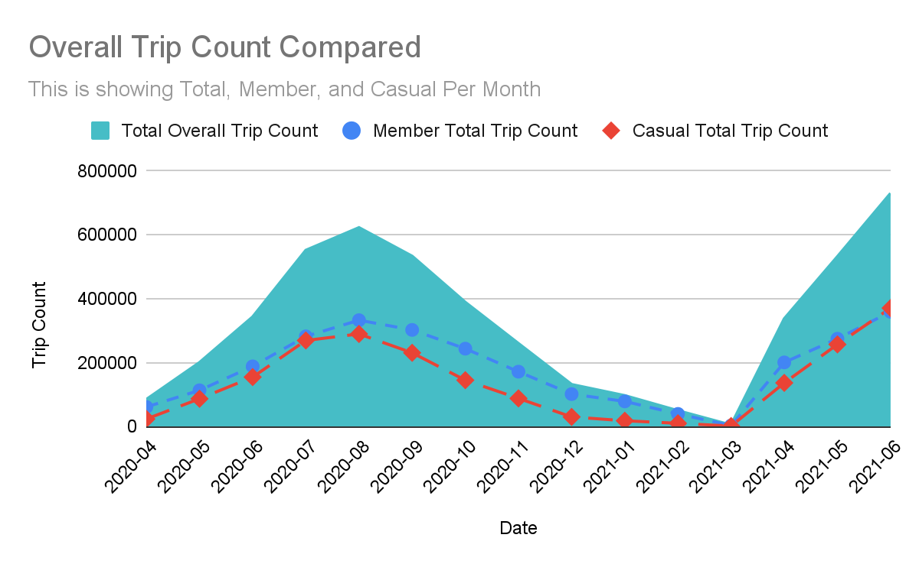
Compared usage
We can see that members have consistently used our service more
Look at how many more trips have been taken in 21 compared to 20

Slide 12
Findings
Members
Use the service more consistently year round
Prefer the Classic bike
Casual
Will use whatever bike they can but prefer the Classic
Are using the service more in 21 than in 20

Slide 13
Recommendations
Replacing the docked bikes with more classic bikes.
When advertising for new membership it will work best for us to do so during the late spring - early fall months when the casual riders use our service the most.
I would recommend that we should look into a seasonal membership for the summer season.

